Slide 1
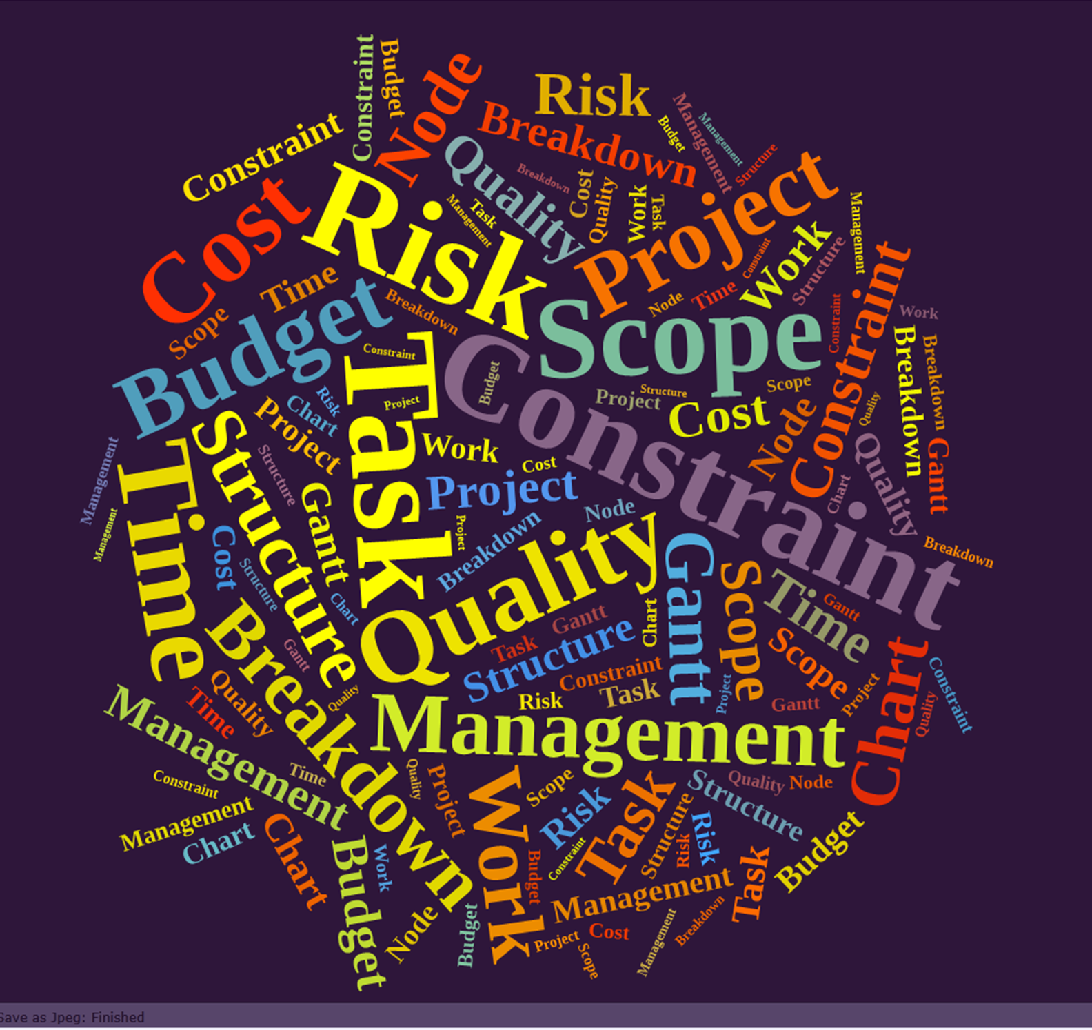
MGMT 3105
Project Management
Lecture 2 G.R. Labbé

Slide 2
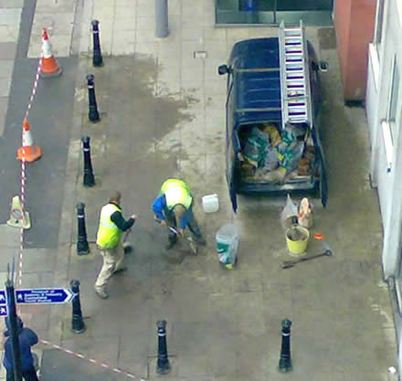
Why are we studying Project Management at Fanshawe?
Because only 26% of projects in the working world today are successfully delivered respecting the triple constraint.

Slide 3

Definitions
Project management is the discipline of organizing and managing resources using a carefully defined set of activities to meet the pre-defined objectives of the client.
The management of a "project" versus a "process" is often very different and requires varying technical skills and philosophy, hence requiring the development of project management.

Slide 4
What is:
a Project?
a Process?
A project is a temporary and one-time endeavor.
A project is a sequence of unique, complex, and connected activities having one goal or purpose and it must be completed by a specific time, within budget, and according to defined specification.
A process is a permanent endeavor, designed to be repetitive, undertaken to create a unique product or service, which brings about beneficial change or added value.

Slide 5
Why are projects important?
Projects help companies overcome these challenges:
1. Shortened product life cycles
2. Narrow product launch windows
3. Increasingly complex and technical products
4. Emergence of global markets
5. An economic period marked by low inflation
Notes:
This slide is about why project management is essential for modern companies. Each point highlights a challenge businesses face and how projects provide a structured way to overcome them:
1. Shortened product life cycles
Products today become outdated quickly due to rapid innovation and consumer demand for the "next new thing."
Projects help companies plan, design, and launch new products faster, ensuring they stay relevant before the product becomes obsolete.
2. Narrow product launch windows
Timing is everything: missing the market window can mean losing competitiveness.
Projects provide detailed scheduling, resource allocation, and risk management to ensure launches happen at the right moment.
3. Increasingly complex and technical products
Modern products (e.g., smartphones, cars, medical devices) require expertise across many fields.
Projects bring together cross-functional teams (engineers, marketers, designers, suppliers) to coordinate complex tasks into one integrated effort.
4. Emergence of global markets
Companies must now deal with multiple countries, regulations, supply chains, and cultural expectations.
Projects help manage this by setting clear goals, standardizing processes, and coordinating global collaboration.
5. An economic period marked by low inflation
With stable but competitive pricing, companies must focus on efficiency and cost control.
Projects enable businesses to streamline operations, reduce waste, and deliver value without eroding profits.
✅ In short: Projects give structure, discipline, and coordination. They allow companies to respond quickly, manage complexity, and stay competitive in a global, fast-moving, and efficiency-driven economy.

Slide 6
Primary and Secondary Challenge of Project Management
The primary challenge of project management is to make sure that a project is delivered within defined constraints.
The second, more ambitious challenge is the optimized allocation and integration of resources needed to meet pre-defined objectives.
Notes:
This slide explains the two central challenges of project management:
1. The Primary Challenge: Delivering Within Defined Constraints
Every project has boundaries—commonly referred to as the triple constraints:
Scope: What the project must deliver.
Time: The schedule or deadline.
Cost: The budget and financial limits.
The primary responsibility of a project manager is to make sure the project is completed on time, within budget, and according to the agreed scope/quality.
If any one constraint shifts (e.g., tighter budget), the others are affected (less scope or longer time).
✅ In essence: The project manager ensures that the project goal is achieved without breaking the agreed boundaries.
2. The Second Challenge: Optimized Allocation and Integration of Resources
Beyond just staying within constraints, the higher-level goal is to make the best use of resources:
Human resources: Assigning the right people with the right skills.
Material resources: Using equipment, tools, and materials efficiently.
Financial resources: Spending wisely to maximize return on investment.
Time resources: Scheduling tasks to avoid waste and idle time.
Integration means coordinating all these resources so they work together smoothly toward the project objectives.
This requires foresight, planning, and adaptability to unexpected challenges.
✅ In essence: It’s not just about finishing the project, but doing so in the most effective and efficient way possible.
⚖️ Traditional, skeptical perspective: The first challenge (meeting constraints) is about discipline—delivering what was promised. The second challenge is about mastery—going beyond just "finishing" to achieving excellence by optimizing limited resources.
Would you like me to also explain this in terms of the “iron triangle” (scope–time–cost) model, so it’s easier to connect to classical project management theory?

Slide 7
Project Management Governing Bodies
The Project Management Institute (PMI), incorporated in 1969, was founded by five volunteers, with its headquarters in Newtown Square, outside Philadelphia, Pennsylvania. It has published several standards related to project management and manages several levels of project management certification.
The standard Project Management Body of Knowledge (PMBOK) guide, currently in its seventh edition, is the only ANSI standard for project management.
There is presently no ISO project management standard, but the International Project Management Association in co-ordination with PMI is in the process of writing one.
As of November 2021, the PMI serves more than 2.0 million professionals including over 650,000 members in 213 countries and territories around the world, with 313 chapters and 14,000 volunteers serving local members in over 80 countries.

Slide 8
Project Constraints
Projects are limited by items called constraints
Cost – mostly labor cost, but also hardware, software, training, etc.
Time (schedule)
Scope (Requirements/objectives)
Resources – people (skills), facilities, equipment, etc.
In reality we can only control and manage at most, two of these constraints
Which constraints can your project tolerate flexibility in?

Slide 9


The Triple Constraint
Time: available to complete the project
Cost: budgeted amount of money to complete the project
Scope: what must be done to complete a projects end result
Quality: Stakeholder Satisfaction and Quality of Product/Service
Scope
Quality
Cost
Time
Notes:
These three constraints are often competing constraints: increased scope typically means increased time and increased cost, a tight time constraint could mean increased costs and reduced scope, and a tight budget could mean increased time and reduced scope.

Slide 10
The 5 main phases in a project
Initiating
Planning
Executing
Controlling
Closing
Often simultaneous

Slide 11
Project Management Process Life Cycle
Executing
&
Controlling
Planning
Initiation
Closing
Resources and Effort
Phase 1
Initiation
Objectives
Baseline
Feasibility
Business Need
Phase 2
Planning
Plan
Budget
Schedule
Finalize Team
WBS
Risk Analysis
Phase 3
Executing
Execute Plan
Monitor Progress
Quality Assurance
Phase 4
Controlling
Change Control
Budget Control
Schedule Control
Risk Management
Performance Report
Phase 5
Closing
Financial Closure
Lessons Learned
Formal Acceptance
Release Resources

Slide 12
Initiating the Project
To begin this process, you must first understand what it is you are trying to do and why you should do it.
You must define the business case for the project. Does it fit within your Project Portfolio?
Are there Project Sponsors available and who are they?
Create the Project Charter and obtain sign off from all the involved parties.

Slide 13
Planning the Project
This is the stage that determines the ultimate success or failure of your project. It is here that the largest amount of work is done to prepare the tools that will be used for the actual management of the project.
Create the Scope Statement
Create the Work Breakdown Structure (WBS)
Create the Network Diagram (AON)
Create the Budget
Create the Risk Assessment and Mitigation Plans
Determine Quality Standards
Create the Project Control System
Create the Communication Protocols

Slide 14
EXECUTIon
This is where the Project Manager transitions from being an active participant in the process to being more of an observer of the process.
Control must be maintained to ensure that all tasks are being completed on time, on budget and meeting all quality requirements.
The Project Manager must be able to focus on the details and see the big picture at the same time. Leadership qualities are most important during this phase of the project.
This is where you lead your team and manage the project.

Slide 15
Controlling
All the Control Processes put in place during the planning phase are now put to the test.
Scope control, change management, schedule control become daily review items.
This phase of the project overlaps the Execution phase and are sometimes grouped as one phase in some textbooks.
Notes:
Control Processes in Action
During the planning phase, project managers establish control mechanisms—rules, monitoring systems, and procedures to keep the project on track.
In the execution phase, these controls are no longer theoretical—they are actively applied and tested against real project activities.
Daily Focus Areas
Scope Control: Ensuring the project doesn’t drift into doing extra, unapproved work (“scope creep”).
Change Management: Evaluating and approving (or rejecting) changes so that they don’t derail cost, time, or quality.
Schedule Control: Monitoring progress daily, identifying delays early, and adjusting resources or timelines to stay on track.
These become routine, daily review items—not occasional tasks.
Overlap with Execution
Control and execution happen at the same time:
Execution = carrying out the actual project work.
Control = continuously monitoring and adjusting to ensure execution stays within plan.
Many textbooks treat them as separate phases (Execution vs. Monitoring & Controlling), but in practice they are interdependent and simultaneous. Some models even group them together.
✅ In short: Execution builds the product or service. Control ensures the project stays within scope, time, and cost limits while adapting to necessary changes.

Slide 16
Closing
This is where the final reviews of budget, schedule and scope are completed. Customer sign off is obtained and resources are returned to their home departments.
This is the most difficult phase to complete effectively and has the most impact on future projects.
Create final project report
Conduct lessons learned
Obtain final payments and provide final payments for any contracted services.

Slide 17
The Hierarchy of Consideration FOR Important Decision Making for Project Managers
Safety
What is best for the company I represent?
What is best for the Project sponsor?
What is best for the customer?
What is best for the suppliers?

Slide 18
Code of Ethics for Project Managers
Ethics (definition) – "That branch of philosophy dealing with values relating to human conduct, with respect to the rightness and wrongness of certain actions and to the goodness and badness of the motives and ends of such actions.
So, you can violate ethics without breaking laws – that is the implication. But like all rules that are broken, there are consequences.
In this case, if you were an accredited project manager, a viable career choice for you, you would have to swear to uphold the Project Management Institute Code of Ethics. Were you to break the code, you would place yourself in conflict with your profession and risk losing your position in business. Violating it severely enough could have legal ramifications.

Slide 19
PMI Code of Ethics – Key Aspects
The code is to be adhered to by all PMI members, PMI applicants, and PMI volunteers. College students studying the art of project management and its materials are not bound to this code of ethics.
The guiding principle of the document is: "As practitioners of project management, we are bound to do what is right and honorable."
The code consists of both aspirational, and mandatory standards of behavior.
RESPONSIBILTY, RESPECT, FAIRNESS, AND HONESTY are the 4 pillars of the project management code of ethics.

Slide 20
PROJECT COMMUNICATIONS
All the process that are required to ensure timely and
appropriate communication of project information.
These processes include:
Plan Communications Management
Manage Communications
Control Communications
Notes:
The Three Core Processes
1) Plan Communications Management
This is the planning stage: deciding what information will be communicated, to whom, how often, and in what format.
Example: Weekly status reports to sponsors, daily stand-up meetings for the team, monthly updates to clients.
Deliverable: Communication Management Plan.
2) Manage Communications
This is the execution stage: actually carrying out the plan—distributing updates, holding meetings, sending reports, maintaining project documentation.
It ensures clarity, accuracy, and consistency in project messaging.
Example: Sending progress emails, updating dashboards, sharing design changes.
3) Control Communications
This is the monitoring and controlling stage: making sure communications are effective and making adjustments if needed.
It involves checking if stakeholders are receiving and understanding information, and resolving any breakdowns or misunderstandings.
Example: If reports aren’t being read, switch from email to quick summary calls; if confusion arises, add clarifying diagrams.
✅ In Summary
Plan = Decide what/how/when to communicate.
Manage = Actually communicate and keep information flowing.
Control = Monitor effectiveness, adapt methods, and ensure alignment.
Together, these processes reduce misunderstandings, prevent delays, and keep stakeholders engaged and informed.

Slide 21
What do we communicate?
l
l
Project plans
Project meetings
Status updates
Organization charts
Requirements – what are we doing?
Contracts
Presentations
Policies and procedures
l
l
l
l
l
l
Notes:
This slide highlights the types of information that need to be communicated during a project. Communication isn’t just about sending emails—it’s about making sure all critical project content is shared clearly with the right people. Here’s what each point means:
1) Project Plans
The roadmap of the project—objectives, timelines, tasks, resources.
Communicated so everyone understands the overall direction.
2) Project Meetings
Discussions where updates, problems, and decisions are shared.
Ensures alignment, problem-solving, and accountability.
3) Status Updates
Reports on progress, milestones reached, risks, or delays.
Keeps stakeholders informed about whether the project is on track.
4) Organization Charts
Visuals showing who reports to whom and who is responsible for what.
Helps clarify roles, responsibilities, and decision-making authority.
5) Requirements – What are we doing?
Clear statement of what needs to be built or delivered.
Prevents confusion about scope and ensures all work matches stakeholder needs.
6) Contracts
Agreements with vendors, partners, or clients.
Communicating terms avoids legal or financial misunderstandings.
7) Presentations
Used to communicate ideas, progress, or results to different audiences.
Often tailored: detailed for the team, high-level for executives.
8) Policies and Procedures
Rules and guidelines that govern how work is done.
Ensures compliance, consistency, and standardization across the project.
✅ In summary: In a project, we communicate plans (where we’re going), progress (how we’re doing), structure (who does what), and rules (how we operate). Together, these communications keep the project transparent, coordinated, and legally sound.

Slide 22
HOW DO WE COMMUNICATE
l
Talking:
one on one,
meetings,
presentations,
phone
Written:
emails,
reports
Paralanguage – the tone we use
Body language
Other
Our actions?
l
l
l
l
l

Slide 23
Performance reporting
Typical performance reports include:
Status report (where the project now stands)
Progress report (what has been accomplished)
Trend report (examining project reports over time to see if performance is improving or deteriorating)
Forecasting report (predicting future project status and performance)
Variance report (comparing actual results to planned)
Earned Value (integrating scope, cost and schedule measures to assess project performance)
Notes:
This slide explains the main types of performance reports in project management. These reports help project managers, teams, and stakeholders understand how the project is doing and whether corrective action is needed. Let’s go through each one:
1) Status Report – Where the project stands now
A snapshot of the current state of the project.
Answers: Are we on time? Within budget? Meeting quality standards?
Useful for stakeholders to know the immediate situation.
2) Progress Report – What has been accomplished
Describes work completed over a certain time period (week, month, milestone).
Focuses on deliverables achieved and tasks finished.
Helps check if the project is moving forward as expected.
3) Trend Report – Performance over time
Examines data across multiple reporting periods.
Shows if performance is improving or deteriorating.
Example: Productivity charts, defect counts, or cost performance trends.
Useful for spotting early warning signs.
4) Forecasting Report – Predicting the future
Projects the likely future status of schedule, cost, or quality.
Answers: If current trends continue, where will we end up?
Helps management decide if interventions are needed now to avoid future problems.
5) Variance Report – Comparing actual to planned
Identifies the gap between what was planned and what actually happened.
Example: Planned budget $500K, actual $600K → variance = +$100K (overspend).
Critical for understanding deviations and taking corrective measures.
6) Earned Value Report – Integrated performance view
Combines scope, cost, and schedule into a single performance measure.
Key metrics:
Planned Value (PV) = what work should have been done.
Earned Value (EV) = value of work actually done.
Actual Cost (AC) = what was actually spent.
Provides powerful indicators like CPI (Cost Performance Index) and SPI (Schedule Performance Index).
Considered the gold standard of performance reporting.
✅ In summary:
Status & Progress = What’s happening now.
Trend & Forecasting = How it’s evolving, where it’s heading.
Variance & Earned Value = How actual performance compares to the plan.

Slide 24
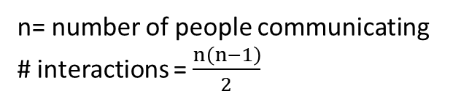
HOW OFTEN WE COMMUNICATE
Parent Organization
Other Functional Managers
External Environment
Project Manager
Customer
Top Management
Accountant
Project Team
n= number of people communicating
# interactions = $\frac{n\left(n−1\right)}{2}$

Slide 25
Project communications management
The process of developing an appropriate approach and plan for project communication based on your stakeholder's information needs and requirements.
Typical elements of the written plan are:
What information needs to be collected and when
Who will receive the information
Methods used to gather and store information
Limits, if any, on who may give information to whom
Reporting relationships
Listing of contact information for all stakeholders
Schedule for distribution of each type of communication
90% of a Project Manager's time is spent communicating.
Notes:
What It Is
It’s the process of planning and managing communication so that stakeholders receive the right information at the right time.
The focus is on stakeholder needs—what they must know, when, and how.
Key Elements of the Written Communication Plan
What information needs to be collected and when – Defines the content and timing (e.g., weekly status reports, monthly budget updates).
Who will receive the information – Identifies all stakeholders and their communication needs (sponsor, team, client, vendors).
Methods used to gather and store information – Could be emails, shared drives, project management software, dashboards.
Limits on communication – Who is authorized to share information and to whom (avoiding miscommunication or breaches).
Reporting relationships – Clarifies the hierarchy (e.g., project manager reports to sponsor, team reports to manager).
Contact information for all stakeholders – A directory to quickly reach the right person when needed.
Schedule for distribution of each communication type – Defines frequency (e.g., daily stand-ups, weekly updates, quarterly presentations).
Why It Matters
Research shows 90% of a Project Manager’s time is spent communicating—through meetings, reports, emails, calls, and stakeholder discussions.
Poor communication is one of the top reasons projects fail.
A solid communications plan ensures clarity, transparency, accountability, and trust throughout the project.
✅ In summary: Project Communications Management is about creating a structured plan that ensures everyone gets the right information, at the right time, through the right channels. It is the backbone of project success.

Slide 26
Manage communications
The process of creating, collecting, distributing, etc. of project information in accordance with the “Plan Communications Management” plan.
Notes:
Manage Communications is about the actual execution of the communication plan.
While Plan Communications Management is about designing what, when, and how to communicate, Manage Communications is about doing it—creating, sharing, and ensuring information flows properly.

Slide 27
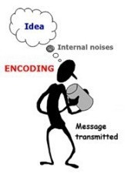
Communication model
To ensure good project communications, the sender should encode a message carefully based upon the
receiver's education,
experience,
language,
and culture.
The sender should determine the ideal communications method and confirm that the message is understood.

Slide 28
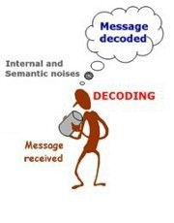
Communication model
The receiver should decode the message carefully and ensure that the message is understood.

Slide 29
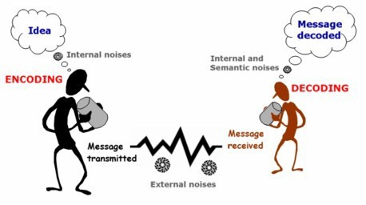
Three elements of communication

There are three elements to all communications. There is the sender, the receiver, and the message.

Slide 30
Four modes of communication
Speaking 23 %
Reading 13%
Listening 55%
Writing 9%
Scientifically least understood

Slide 31
Communication concepts
Active Listening – The receiver confirms that he/she is listening by agreeing and/or asking for clarification.
Effective Listening – Watching the speaker to pick up physical gestures and facial expressions, thinking about what you say before responding, asking questions, repeating and providing feedback.
Feedback – Saying things like, "Do you understand what I have explained?" usually asked by the sender. Nodding, facial expression of the receiver.
Nonverbal – about 93% of all person to person communications are non- verbal.
Body Language 55%
Tone of voice 38%, changes to 86% on the phone
Notes:
1. Nonverbal Communication
About 93% of person-to-person communication is non-verbal.
Breakdown:
Body Language – 55% (gestures, posture, facial expressions).
Tone of Voice – 38% (intonation, emphasis, speed).
On the phone, tone becomes even more important (up to 86%) since body language is absent.
Words themselves often matter less than how they are delivered.
2. Active Listening
The receiver shows they are listening by agreeing, nodding, or asking clarifying questions.
It’s about demonstrating attentiveness and engagement.
Example: “So what you’re saying is…?”
3. Effective Listening
Goes deeper than just hearing words.
Involves watching the speaker’s physical cues, processing information carefully before responding, and ensuring thoughtful engagement.
Skills include: asking relevant questions, paraphrasing, and reflecting back what was heard.
4. Feedback
A two-way loop—essential for confirming understanding.
Examples: “Do you understand what I explained?” or the listener nodding/smiling to show comprehension.
Feedback helps both sender and receiver ensure the message has been received accurately.
✅ In summary:
Most communication is nonverbal.
Good communicators practice active listening (showing engagement), effective listening (understanding deeper meaning), and feedback (closing the loop).

Slide 32
Listening filters
Selective Attention, we decide what to focus on.
Selective Interpretation, we place our own meaning on what the person is saying
Selective Retention, we decide whether to keep pieces of information and for how long
Notes:
1) Selective Attention
We choose what to focus on and ignore the rest.
Example: In a noisy meeting, you tune out background chatter and focus only on your manager’s instructions.
Risk: You might miss other important details.
2) Selective Interpretation
We assign our own meaning to what someone says, shaped by our experiences, biases, or expectations.
Example: If a teammate says, “We should review the plan,” one person may hear it as helpful collaboration, another as criticism.
Risk: Misunderstanding the speaker’s true intent.
3) Selective Retention
We decide what information to keep and for how long.
Example: You may remember only the deadline from a meeting but forget the detailed instructions.
Risk: Losing critical context or recalling only what fits your perspective.
✅ Why It Matters
These filters are natural but can distort communication.
Awareness helps us listen more actively and minimize bias—ensuring better understanding and fewer misinterpretations.

Slide 33
Selective attention
 People listen at 500 Words per minute
 People speak at 150 Words per minute
 That leaves 350 words per minute to TUNE OUT which represents (42 seconds)
 Causes for TUNING OUT?
Receiver purpose is different from sender's purpose
Under stimulation
Over stimulation (hot button)
Pace and delivery
Notes:
The Listening vs. Speaking Gap
Listening capacity: People can process about 500 words per minute.
Speaking speed: People usually speak around 150 words per minute.
Gap: That leaves about 350 words per minute worth of unused listening capacity—equivalent to 42 seconds of mental space.
Result: Listeners often drift, think about other things, or “tune out” while the speaker is talking.
Causes for Tuning Out
Different Purposes
The receiver’s focus or purpose may not match the sender’s.
Example: A manager shares strategic updates, but the team just wants to know daily tasks.
Under Stimulation
The message is too slow, repetitive, or unengaging.
Listeners get bored and let their mind wander.
Over Stimulation (Hot Button Issues)
A topic triggers strong emotions (anger, excitement, defensiveness).
The listener fixates on that point and stops hearing the rest.
Pace and Delivery
Monotone voice, unclear articulation, or poor pacing can cause the audience to lose focus.
Good delivery skills help keep attention aligned.
✅ In Summary
Selective attention happens because people can think much faster than others can talk. If the content isn’t engaging or doesn’t align with their needs, listeners mentally fill the gap with their own thoughts, leading to distractions or misunderstandings.

Slide 34
WII-FM
What's In It For Me?
Everything anyone says to you must go through your antenna and be processed through your WII-FM.
If there is something in it for you, you will continue to pay attention and listen
If not, you are at least partially mentally gone.

Slide 35
SELECTIVE INTERPRETATION
Gender Patterns
Generational Patterns
Geographic Patterns
Cultural Patterns
Educational Patterns
Occupational Patterns
Notes:
Examples of Interpretation Filters
Gender Patterns
Men and women may interpret communication styles differently.
Example: Direct feedback may be seen as “efficient” by some and “harsh” by others.
Generational Patterns
Different age groups value different communication approaches.
Example: Younger employees may prefer quick texts, while older ones expect formal emails.
Geographic Patterns
Regional language, slang, or accents affect understanding.
Example: The word “tea” may mean dinner in some regions, just a beverage in others.
Cultural Patterns
Norms and traditions influence meaning.
Example: Silence may mean agreement in one culture, but disagreement in another.
Educational Patterns
People with different educational backgrounds interpret technical terms differently.
Example: “Baseline” might mean one thing in project management, another in statistics.
Occupational Patterns
Professional jargon and perspectives vary across fields.
Example: “Risk” in finance vs. “risk” in healthcare carries very different meanings.

Slide 36
Listening de-railers
Listening without Focus:
Multitasking of your mind, listening to someone while thinking about something else.
Listening without Respect: Impatience
Deciding that what the other person is going to say will be wrong, so you interrupt and tell them what they should think. They assume a direction the conversation is going, tune out and then respond with what they thought was said.
Listening without Respect: Too much ego
Failing to listen to the message of another from within their context and perspective rather only from yours. This is a huge loss in opportunities!
Listening with Bias: Defensive
Developing your response to what you are hearing while the other person is still talking to you.
Extremely bad is adverse listening. You listen with a focus to pick out points of difference so you can negate the perception of another.

Slide 37
Tips to improve listening skills
Act like a Listener Listen to Understand Stop talking
Give your complete attention Look at the other person
Empathize (put yourself in the other's shoes) Make understanding your goal
Ask questions Remain neutral Take notes
Analyze nonverbal signals and feelings Hold your rebuttal
Listen to answers given in response
Gain verbal agreement to decisions and action plans
It is important not only to understand, but to check for understanding realize that listening is hard work
Practice regularly (come to my classes!) Remember that everyone is unique

Slide 38
Communication methods
When you should use what........
Formal Written is used when relating complex problems, project plans, project charters, or communicating over long distances.
Formal Verbal is used for presentations and speeches.
Informal Written is used to express memos, e-mails (careful,
e-mails are also contracts), texts, and other notes.
Informal Verbal is a style best reserved for meetings and conversations.

Slide 39
CONTROL OF COMMUNICATIONS
Should a Project Manager try to control all communications between team members and outside of the team?
Yes!
Can a Project Manager control all communications?
No!

